Slide 1
Introduction to Databases / SQL VS NoSQL
Introduction to Databases Checkpoint

Slide 2
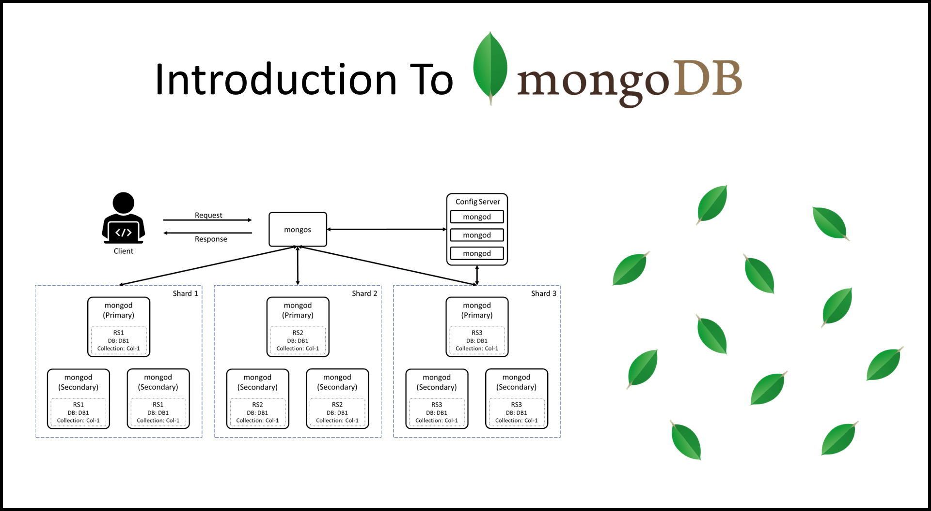
Introduction à MongoDB
Key Points:
Stores data in documents (JSON-like format).
Flexible schema and horizontal scalability.
Built for handling unstructured data and high availability.
Visual: Diagram of MongoDB's document-based structure.

Slide 3
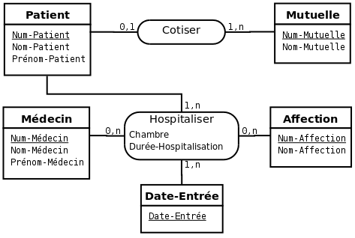
Introduction à SQL
Key Points:
Stores data in tables with a fixed schema.
ACID compliance ensures data integrity.
Uses SQL for complex queries and transactions.
Visual: Diagram showing a relational table structure.

Slide 4
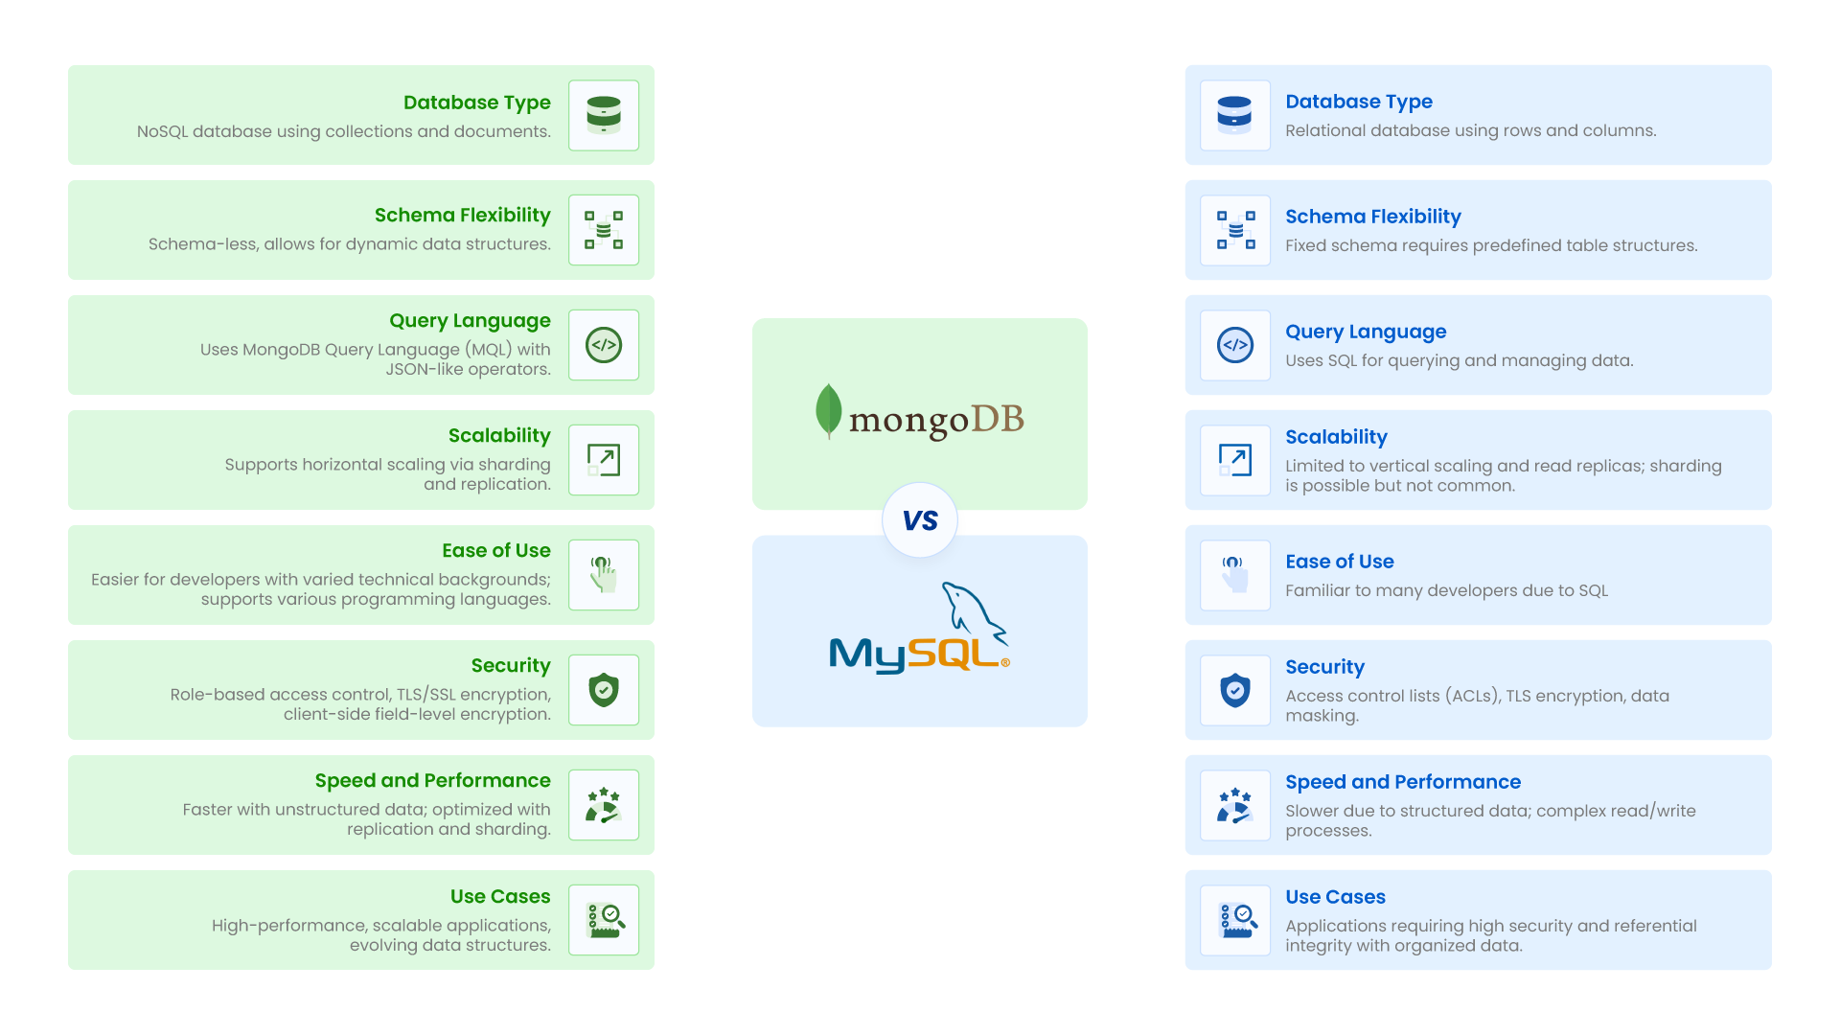
Comparaison de la structure des données
MongoDB:
Data as documents: { "name": "John", "age": 30 }.
SQL:
Data as tables: | name | age | | John | 30 |.
Visual: Side-by-side comparison of MongoDB document vs SQL table.

Slide 5
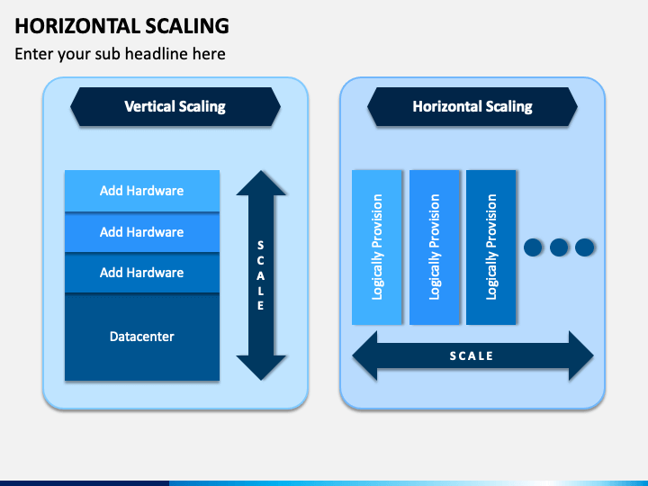
Scalabilité et performance
MongoDB:
Supports horizontal scaling (data sharding across servers).
SQL:
Primarily vertical scaling (upgrading a single server).
Visual: Graph comparing horizontal vs vertical scaling

Slide 6
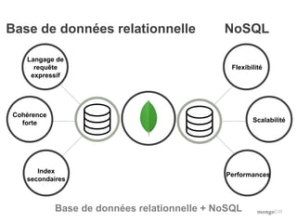
Cas d'utilisation et conclusion
MongoDB:
Ideal for dynamic data (e.g., real-time analytics, social media).
SQL:
Best for structured data and transactions (e.g., banking, inventory).
Conclusion: MongoDB for flexibility, SQL for structured transactional data.
Visual: Use case icons for MongoDB and SQL.

